Slide 1
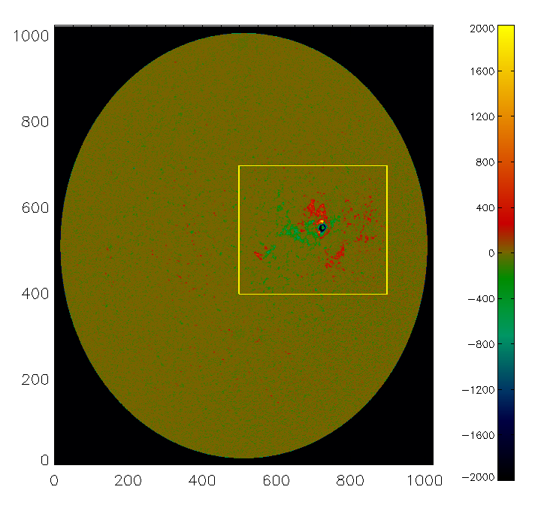
MDI Magnetogram
mdi.fd_M_96m_lev182.20061209_124800_TAI.data.fit
We extrapolate the marked region x=500 ...899, y=400...699
(stored in AR_x500-899_y400-699_12:48.sav)
with a potential field and two linear force-free models (alpha +-4)

Slide 2
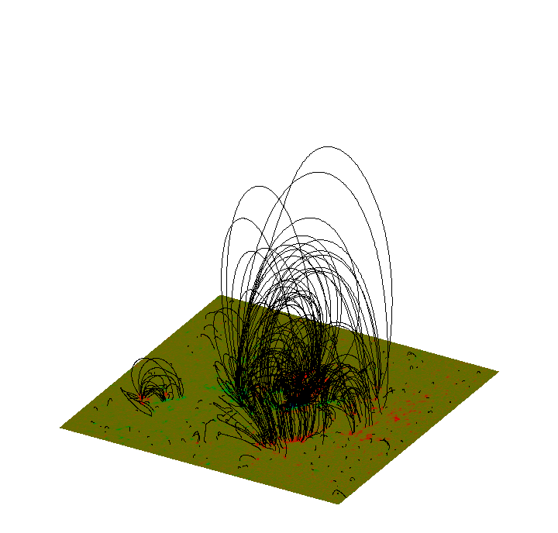
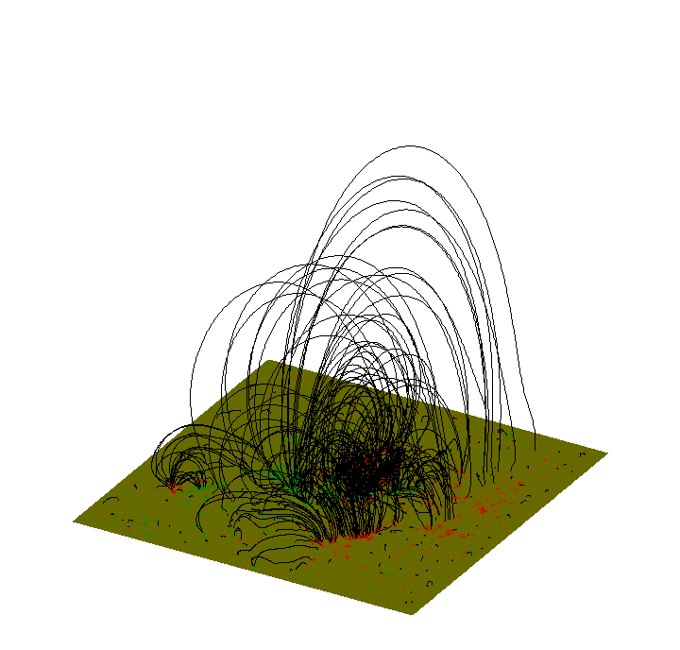
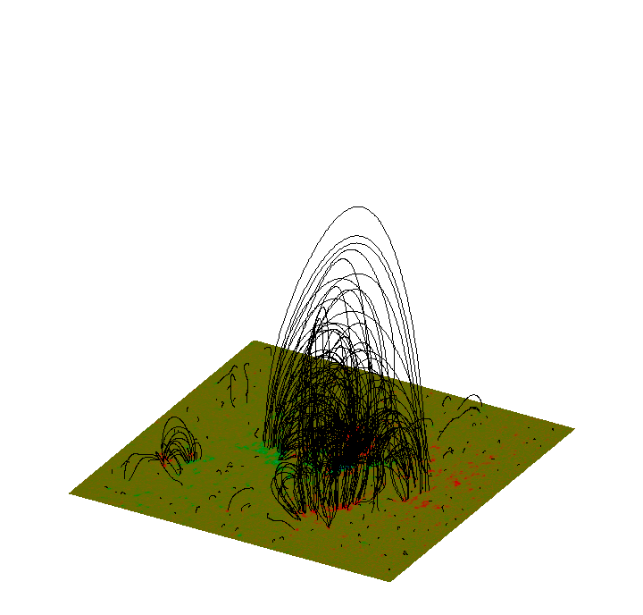
Potential (alpha=0)
Linear Force-free (alpha=4)
Linear Force-free (alpha=-4)

Slide 3
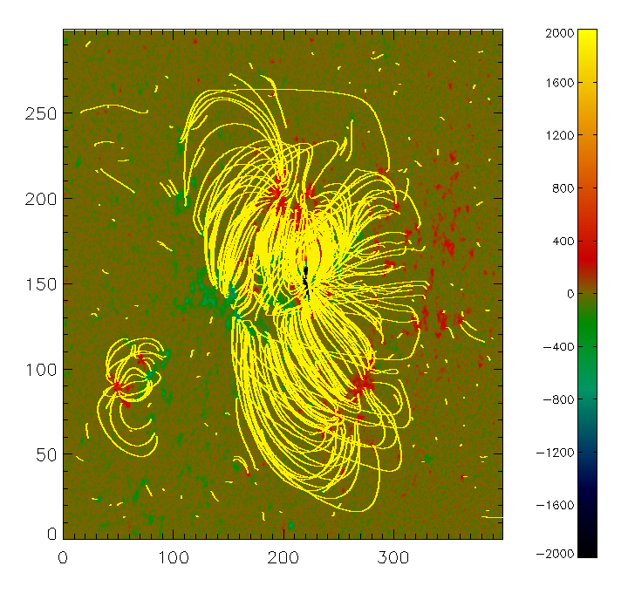
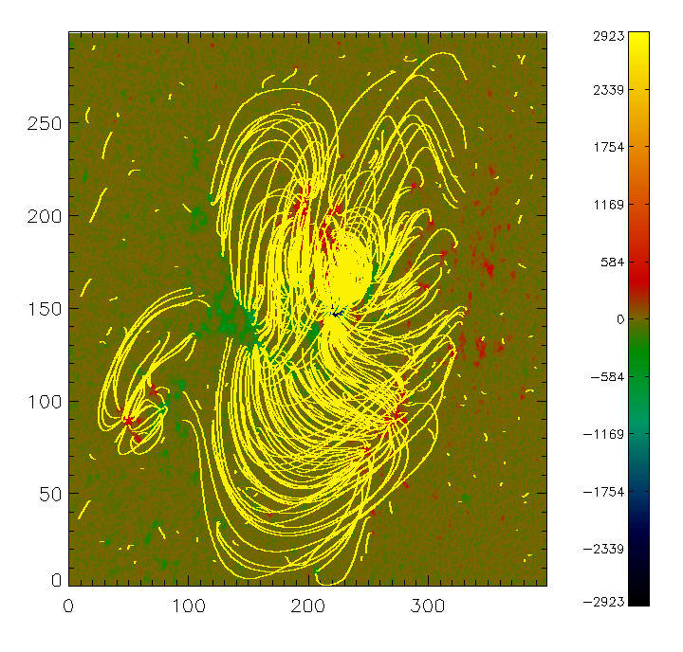
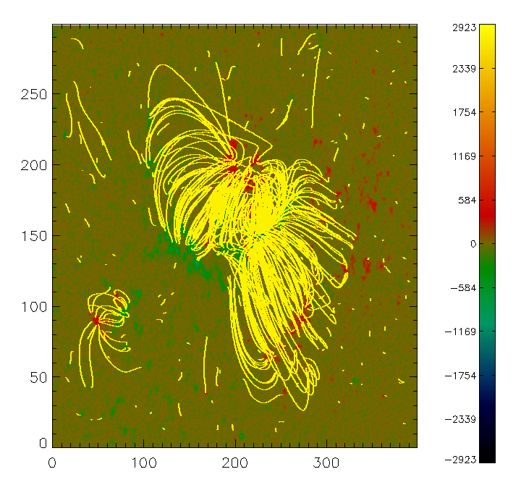
Potential (alpha=0)
Linear Force-free (alpha=4)
Linear Force-free (alpha=-4)
The shown fieldlines are stored in the files
alpha_minus4_loops.sav alpha_plus4_loops.sav pot_loops.sav
We can compute more and other fieldlines.
The 3D data-cubes (400 x 300 x 200 in x,y,z) are stored in
Balpha_plus4__AR_x500-899_y400-699_12:48.sav full_disk_12:48.sav,
Balpha_minus4__AR_x500-899_y400-699_12:48.sav, Bpot_AR_x500-899_y400-699_12:48.sav

